Slide 1
Ticketing Analytics Dashboard
User Guide

Slide 2
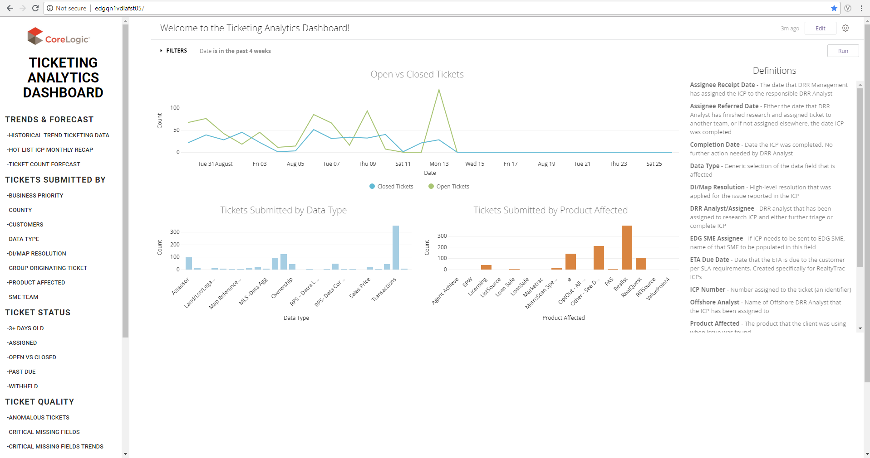
Home Screen
Navigating the Ticketing Analytics Dashboard (TAD)
The Home Screen displays all of the metric names down the left hand side of the user interface and a view of a handful of metrics
Definitions of fields are also located here for more information

Slide 3
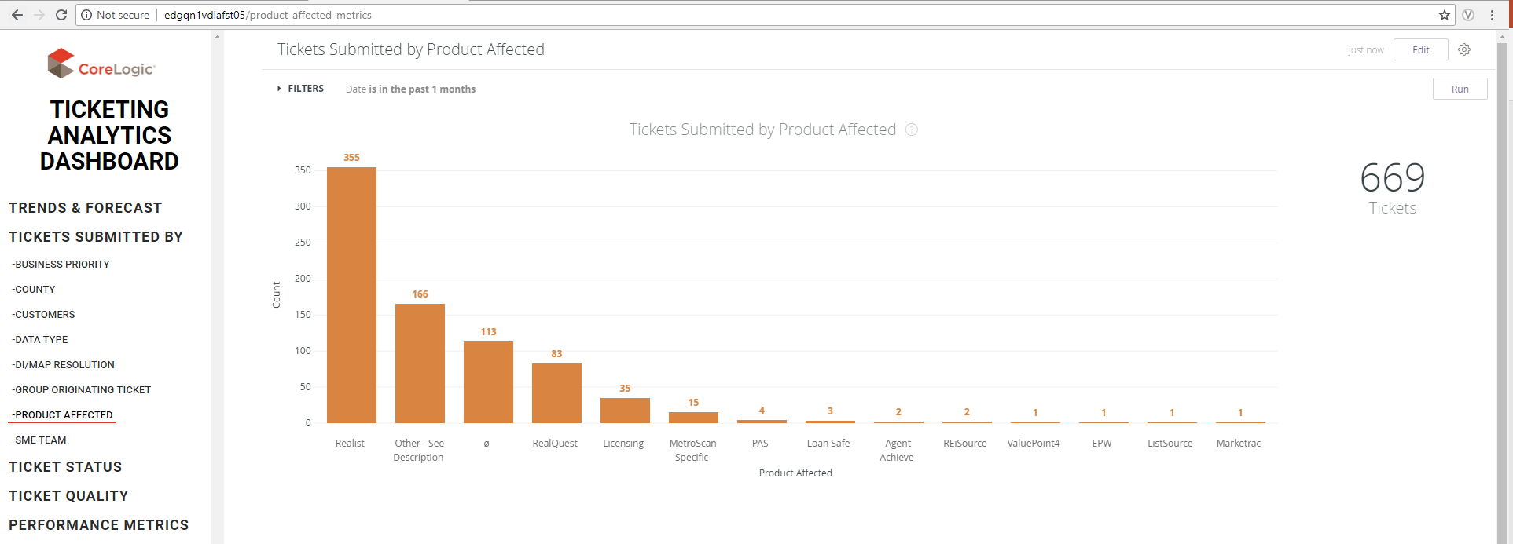
A Look Inside the Metrics
Exploring Visualizations
When clicking a metric, the page will update with the visualization
An underline bar appears under the metric clicked
The title of the Looker dashboard appears and the name of each visualization appears

Slide 4
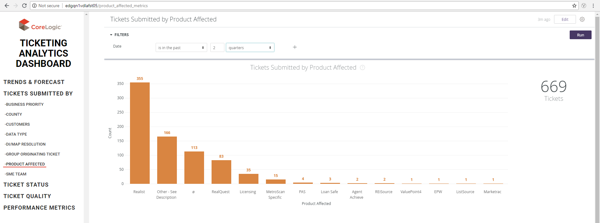
A Look Inside the Metrics
Adjusting Filters
1
2
3
If you click the FILTERS tab, you can change the date range
Hit “Run” to update the visualization

Slide 5
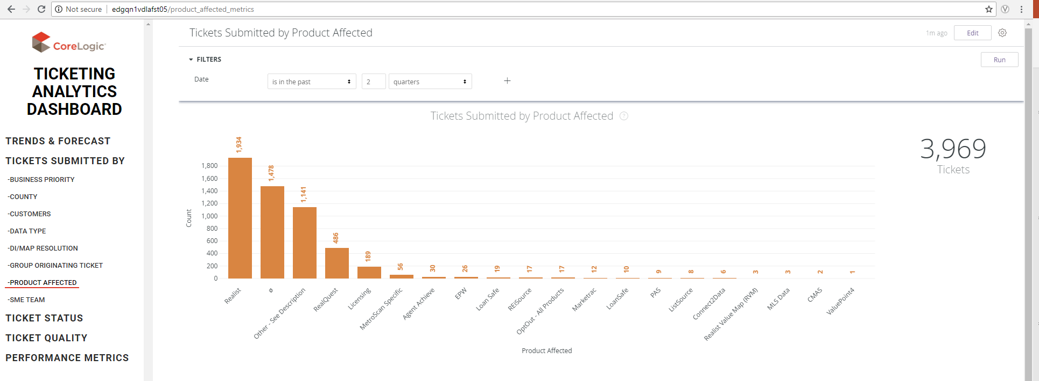
A Look Inside the Metrics
Updated Visualization from Filter
Now you can see the graph has updated and the ticket count on the right hand side of the screen has too

Slide 6
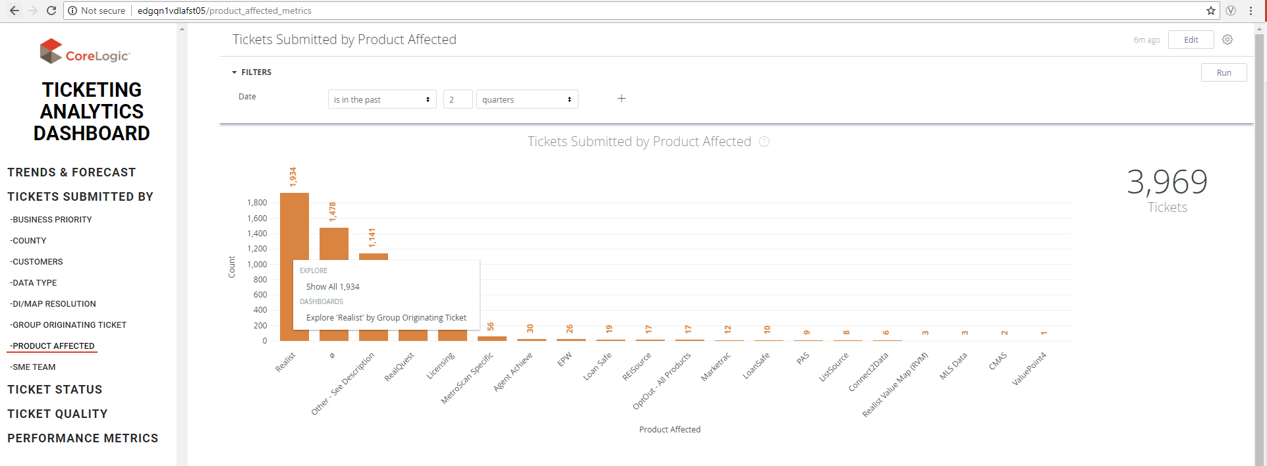
A Look Inside the Metrics
Drill Fields
Drilling into the data requires one mouse click on one of the bars in the graph (in this instance)
Explore > “Show all 1934” – Drills into a table
Dashboards > Explore ‘Realist’ by Group Originating Ticket – Drills into another visualization

Slide 7
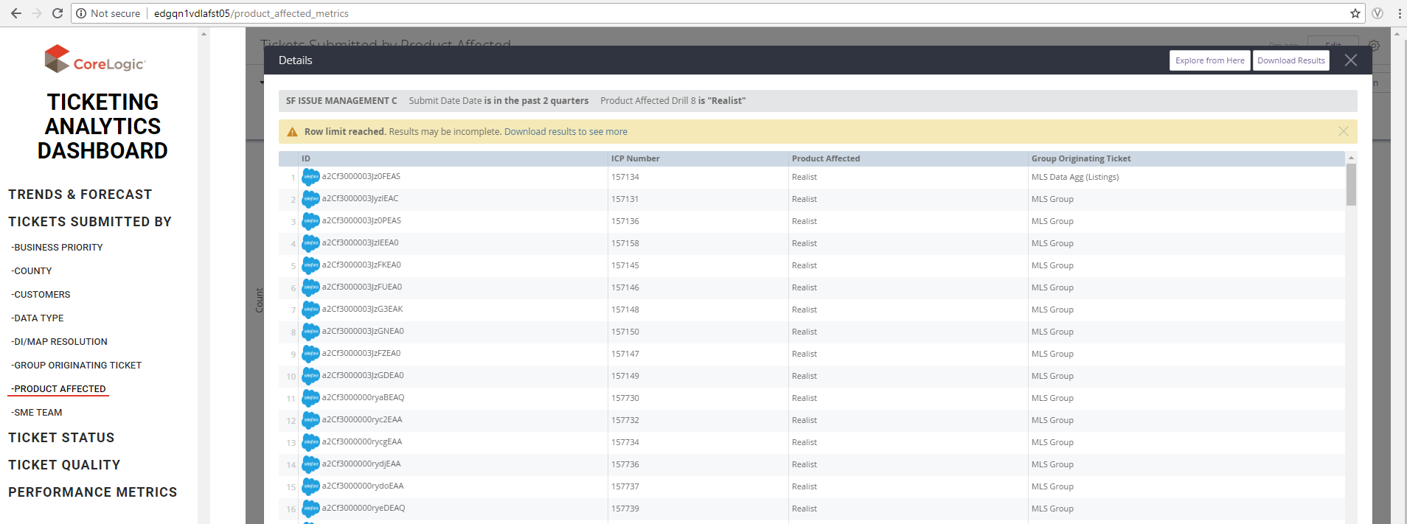
A Look Inside the Metrics
Drill Table
Explore > “Show all 1934”
Drilling into the table shows relevant fields set up in the backend of Looker

Slide 8
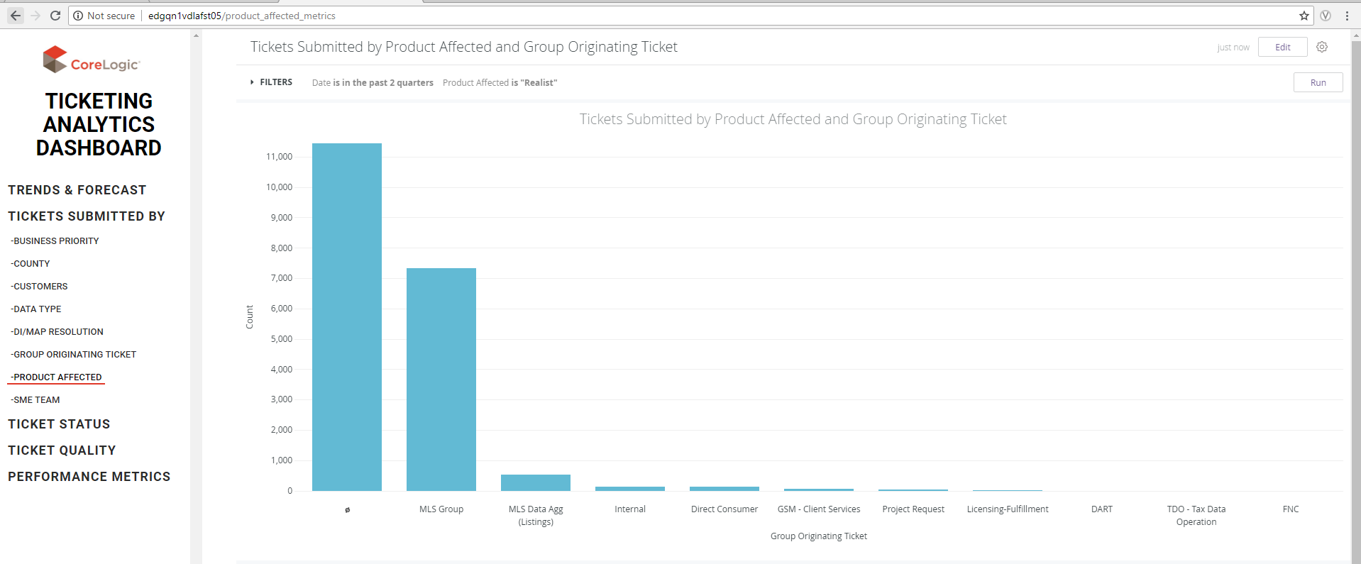
A Look Inside the Metrics
Visual Drill
Dashboards > Explore ‘Realist’ by Group Originating Ticket
Drilling into another visualization (visual drilling) shows data one-level lower
The field selected, “Realist” is now filtering this dashboard as well as the “Date” located in the FILTERS Tab

